Slide 1
Application Lifecycle Management (ALM)

Slide 2
Helping Teams Deliver Together
How Software Development Has Changed & What That Means

Slide 3
The Agile Manifesto Changes Everything
The agile manifesto challenged the orthodoxy around software development, freeing it from the tyranny of process and rigidity, and embracing user feedback and change.
Traditional Waterfall Methodology
Requirements
Gathering
Business Design
Technical Design
Systems Development
Unit
Testing
Integration
Testing
Acceptance
Testing (UAT)
Release Complete
Agile Methodology
Limited Upfront Planning
Release #1
Release #2
Release #3
Release #4
It 1
It 2
It 3
It 4
It 5
It 6
It 7
It 8
It 9
It 10
It 11
It 12
Release Complete
Iteration N
Iteration Planning
Development, Continuous Integration, Unit Testing, Functional & Acceptance Testing

Slide 4
Agile – Led to Continuous Delivery
Organizations quickly realized how much more efficient they could be having integrated teams that collaboratively define the requirements, plan the releases and sprints, test the product during development and deploy the latest update in a seamless way
Release Plan
Iteration
Iteration
Scope
Iteration
Plan
Tested,
Integrated
Working
System

Slide 5
ALM Unifies Test & Dev
With the rise of agile methodologies such as Scrum, XP and Kanban, these three separate "stove-piped" worlds could no longer exist. The term Application Lifecycle Management (or ALM) was the unification of development and testing into a single process

Slide 6
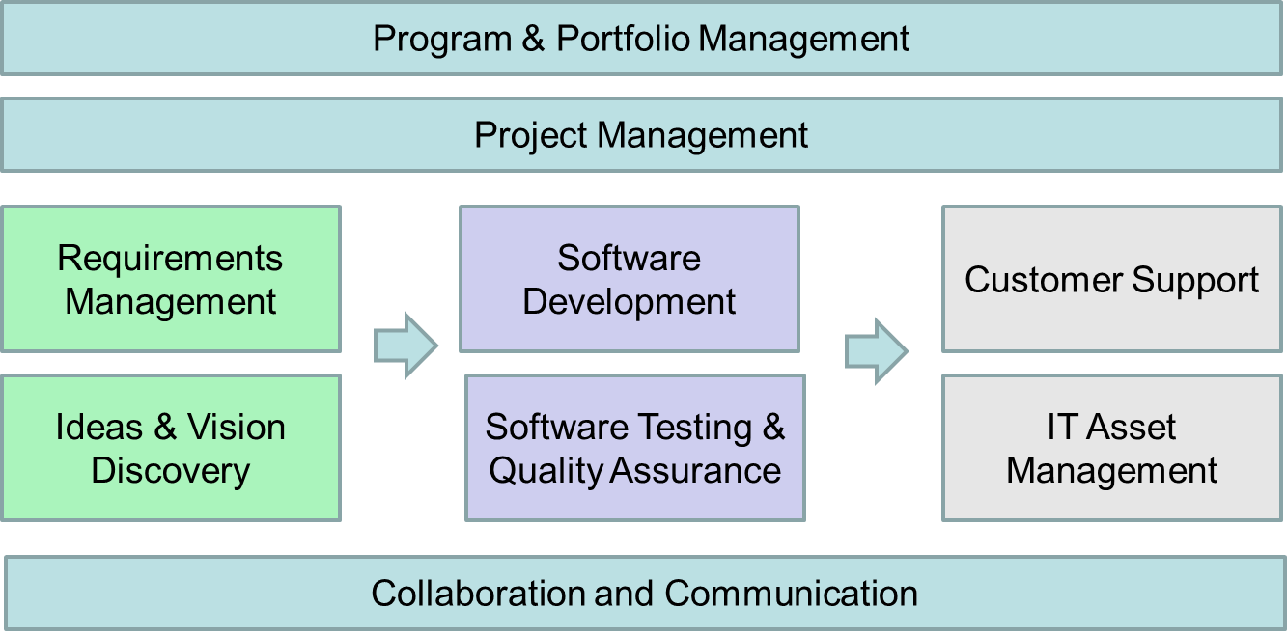
What is ALM Anyway?
Application Lifecycle Management (ALM) is really an umbrella term that covers several different disciplines that traditionally were considered separate:

Slide 7
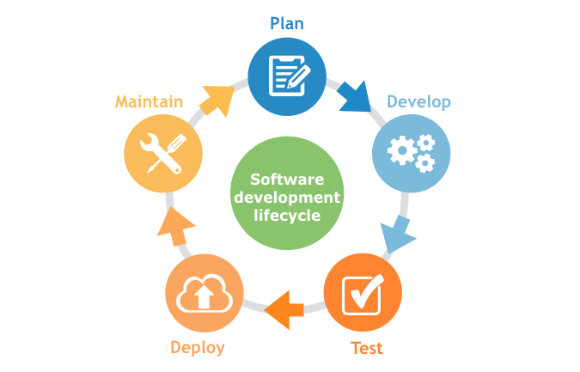
How ALM Brings It All Together
ALM is basically the fusing together of the disciplines concerned with all aspects of the software delivery process.
It encompasses project management, requirements management, development, testing and quality assurance, as well as customer support and IT service delivery

Slide 8
But What About Infrastructure & Operations?

Slide 9
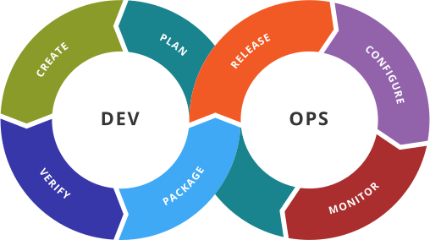
Development & Operations (DevOps)
ALM unified software development and testing, but the IT infrastructure (Operations) was missing from the picture…
The logical next step has been the unification of all three disciplines into a single integrated process called DevOps.
Enter SpiraTeam® to help teams work together in DevOps and Agile.

Slide 10
The SpiraTeam Difference
How are we different and what our customers say

Slide 11
Introducing the Inflectra® Suite
KronoDesk®
IT Support & Help Desk
SpiraCapture™
Exploratory Testing
SpiraPlan®
Agile Program & Portfolio Management
SpiraTeam®
Application Lifecycle Management (ALM)
SpiraTest®
Requirements, Test Management
& Bug Tracking
TaraVault® - Source Code Management
Rapise®
Test Automation (Web, GUI, Services)

Slide 12
SpiraTeam – The Integrated ALM Platform
KronoDesk®
IT Support & Help Desk Ticketing
SpiraTeam®
SpiraTest®
Requirements, Test & Defect Management
Agile Project Management
+
TaraVault® - Source Code Management & DevOps
Rapise®
Test Automation Platform (Web, GUI, Services)
See Spira Comparison Matrix to compare SpiraTeam vs. SpiraTest

Slide 13
harmony
Notes:
Make great products
Help you work together
Help you deliver your products faster, more easily, with less pain, and less stress
At a grand scale – we’re passionate about making products that you will find transformative to how you work.
We both want to use our tools every day to help you do a whole number of complex things, and at the same time get out of your way so you don’t need to worry about SpiraTeam and can instead focus on helping your own customers

Slide 14
How Do We Foster Harmony?
Across Disciplines
Through Simplicity
Across Ecosystems

Slide 15
Harmony Across the Disciplines
Testers
Developers
Managers
We consider each of these three stakeholders groups when designing features for SpiraTeam, so that everyone in teams can get the most out of the system working together.

Slide 16
Simplicity = Productivity from Day One
Less Time Doing:
More Time Doing:
No plugins, customization or configuration needed day one

Slide 17
If all you have is an ‘issue’ tracker…
Then everything is an issue…

Slide 18
Instead, SpiraTeam Guides Your Process
Create Product
Add Users to Product (Membership)
Follow Product Workflow:
Requirements Planning
Test Planning
Sprint Planning
Schedule & Resourcing
Tracking & Execution

Slide 19
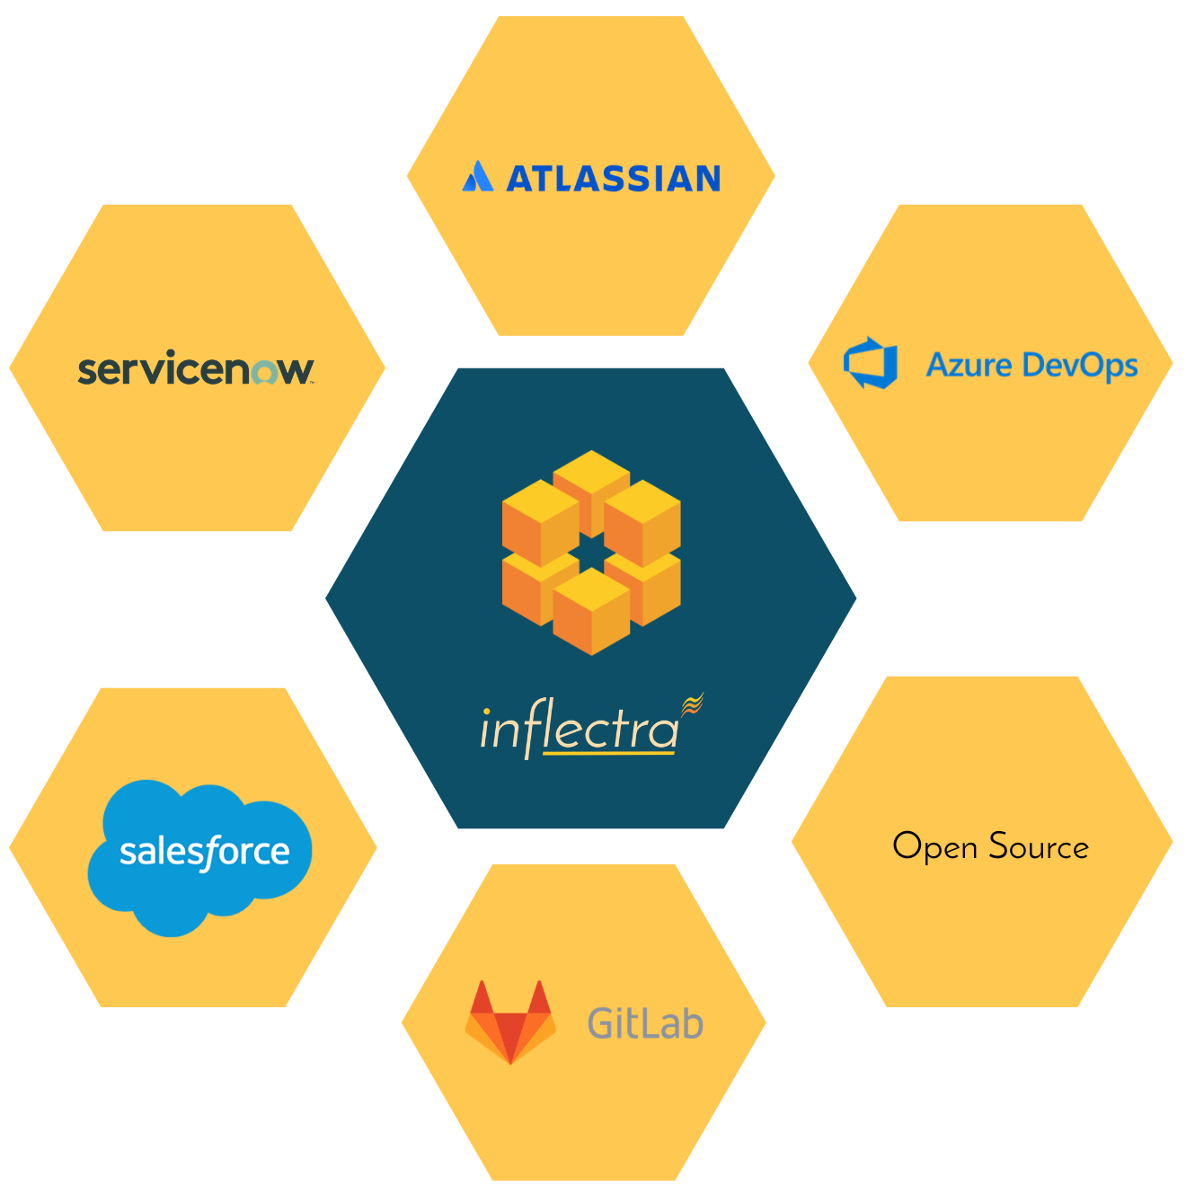
Harmony Across Ecosystems
We recognize that you need to integrate SpiraTeam with other tools and systems
We make this easy and straightforward so you can get working faster & easier

Slide 20
Inflectra Core Values
Great Products: Build for Our Users Not Investors
Building great software for customers, not chasing the latest fad.
Great Team: We Just Get it Done
Treat customers well, solve their problems, no drama or red tape.
Great Workplace: Family and Life Flexibility
Unlimited vacation, amazing benefits, flex/part time welcomed.
Great Community: Enabling Second Acts
Expanding opportunities for new/second careers in technology.

Slide 21
How SpiraTeam Works For You
Features for different industries and methodologies

Slide 22
Bridging Between Agile and Compliance
Support for Regulated Processes
Modern, Agile Processes
Baselining
Risk Management
Electronic Signatures
Data Privacy
Compliance
Workflow
Requirements Mgt
On-Premise
CI / CD
Scrum
Kanban
Scaled Agile
DevOps
Distributed Teams
Remote Working
Cloud-Based

Slide 23
Healthcare & Life Sciences
Electronic signatures for FDA 21 Part 11 compliance
Secure hosting with support for HIPAA BAA agreements
End to end traceability of requirements, tests, and code
Validated platform where you control update cadence

Slide 24
Financial Services & Insurance
Secure cloud platform (SOC2) or on-premise deployment
Generate financial compliance documentation automatically
Integration with automated testing and verification tools
End-to-end traceability and auditability of testing

Slide 25
Energy, Industrial, & Automotive
Testing for public safety with world class test management
Define requirements and test for compliance
Integrate standards and regulations into your test plans
Understand and manage risk of critical systems

Slide 26
Defense, Government & Aerospace
Manage programs and portfolios across platforms
Test step level traceability for mission systems
Automate testing and compliance with RemoteLaunch
Security and privacy with on-premise and AWS GovCloud

Slide 27
Representative Customers by Industry
We have ~ 80,000 users in 5,000+ companies worldwide:
Energy & Industrial
Financial & Business Services
Government & Defense
Information Technology
Healthcare & Bio-Technology
Telecommunications
Retail & Consumer Goods
Transportation & Hospitality

Slide 28
Regulated Industries - Automating Compliance
End-to-end traceability out of the box
Data Privacy, Security baked in
Generate Documentation from data
Workflows & Electronic Signatures
Integration across the software value chain

Slide 29
Compliance with International Standards
EudraLex Volume 4 Part I & II
Guidance on Data Integrity

Slide 30
Global Partner Network
North America
South America & Mexico
Asia
Europe
Australia
Middle East & Africa

Slide 31
Customer Testimonials
“
Great product for managing your software development projects. When evaluating solutions, it became clear to me that the choice would be SpiraTeam. For the price to feature ratio, it could do everything and more than we would need. With the ability to just add additional licenses as our team grew it provided the flexibility we needed. The support team at Inflectra is also top notch. Any time I had a question/issue, they were there to help in a quick and friendly manner.
- Brian Kratsch, Tolko Industries Ltd.
“
Inflectra’s SpiraTeam is disrupting this market. And deservedly so. If you’re in the market for an ALM tool, I recommend you put SpiraTeam at the top of your shortlist. This is a great suite for managing the application development life cycle. Very competitive in features and functions.
- Jim Reardan, Process1st Consulting
“

Slide 32
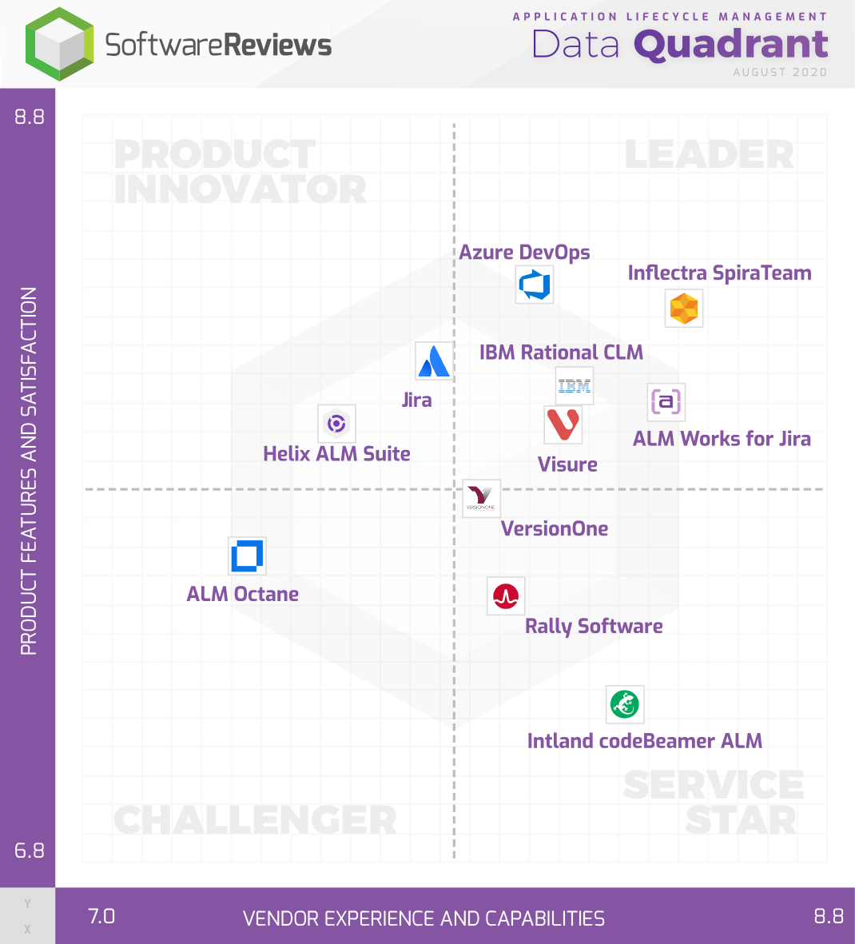
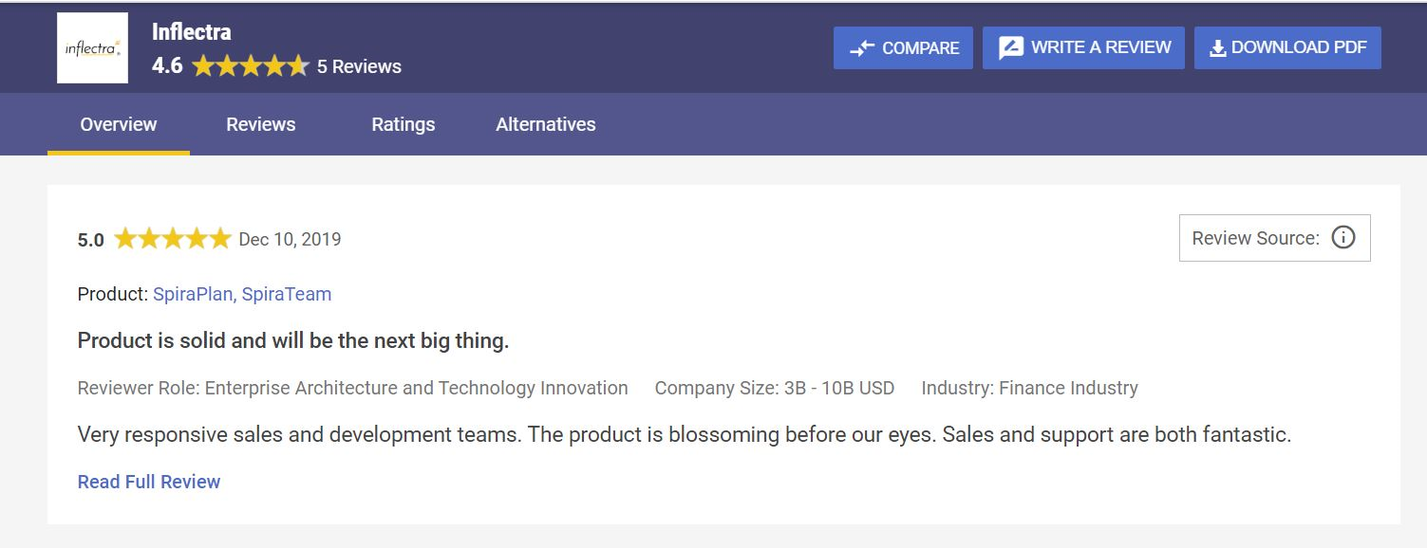
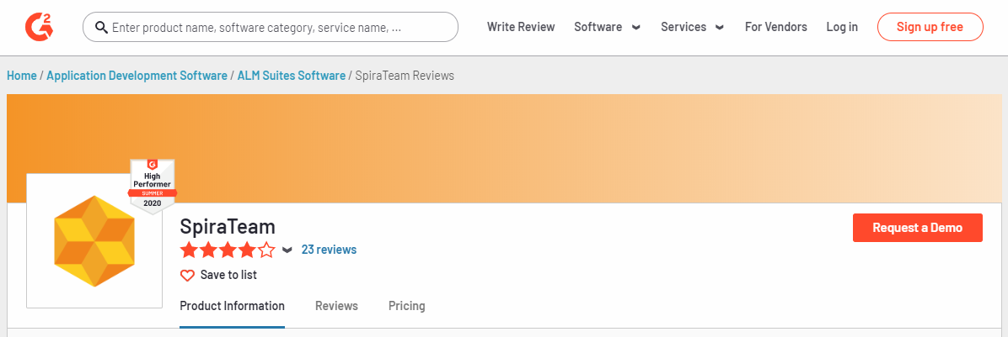
Awards and Recognition*
*Gartner, G2 Crowd, InfoTech

Slide 33
Feature Overview
Lets Look at the Key Features in SpiraTeam

Slide 34
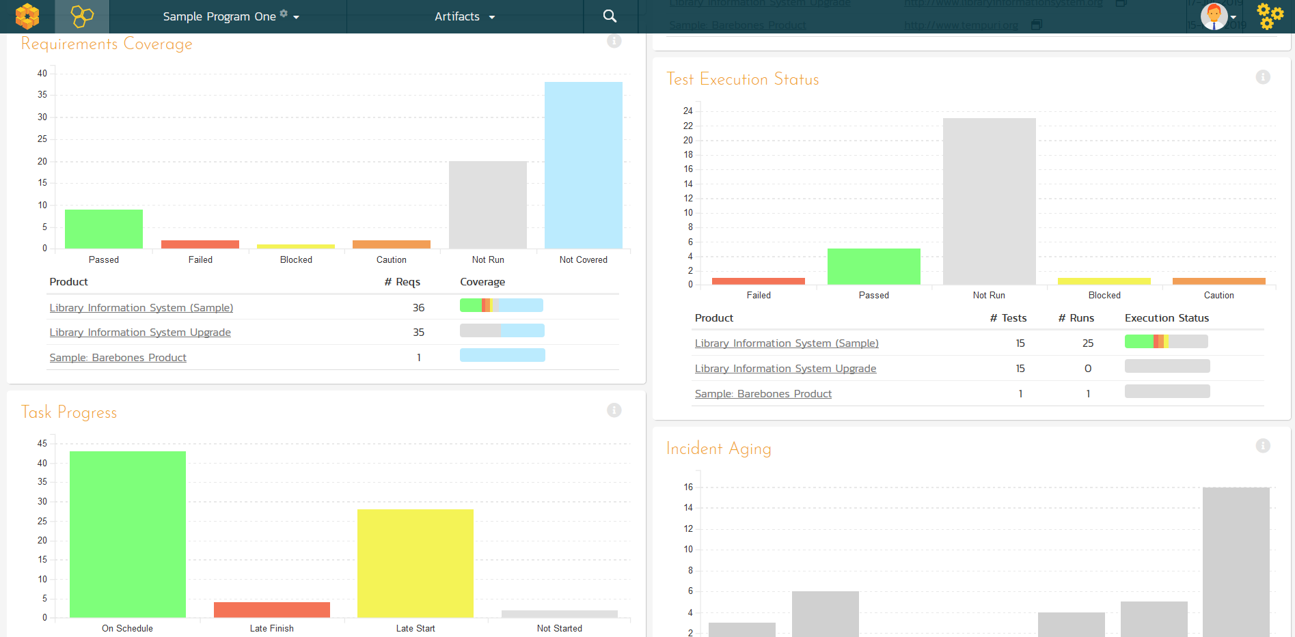
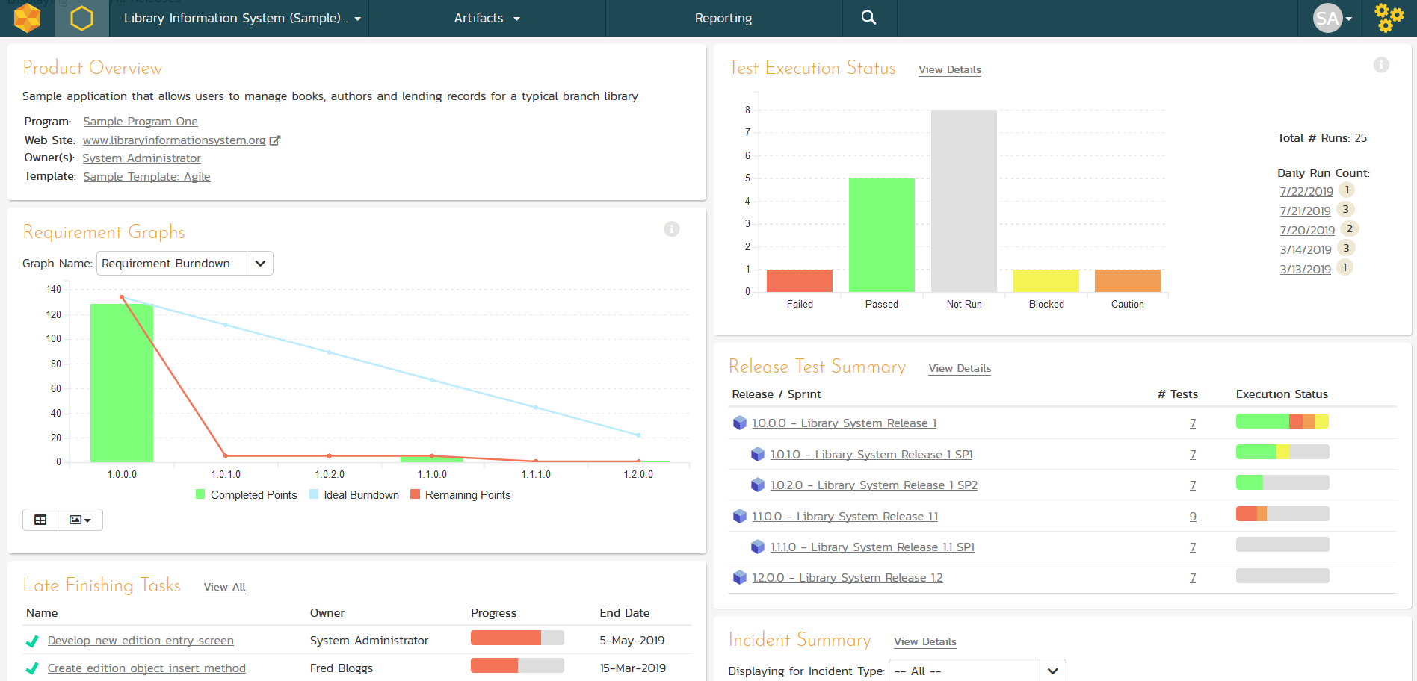
Integrated Program & Project Dashboards
Customizable reporting dashboards at the program, product, project, release and sprint levels

Slide 35
Managers
Notes:
Managers, our third pillar, could always take advantage of our reporting, dashboards, and traceability features. But we knew we could do a lot more to help managers – both senior leaders and those in other roles like BI

Slide 36
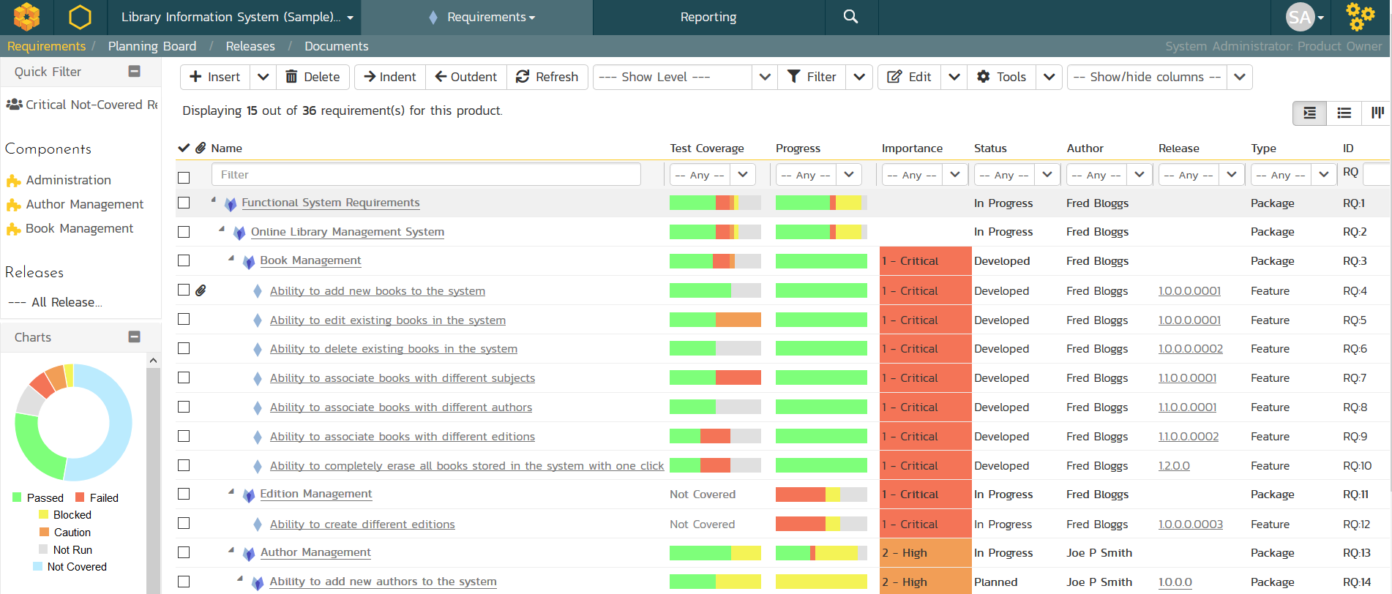
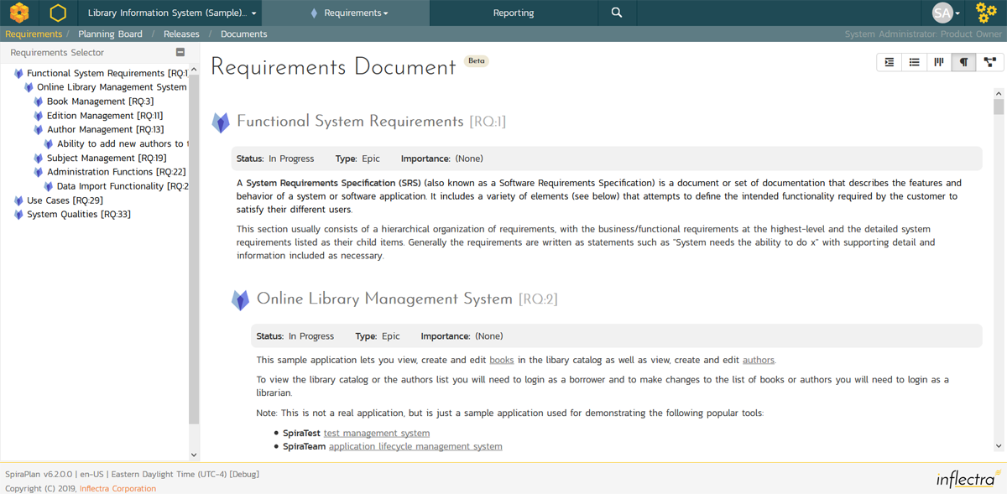
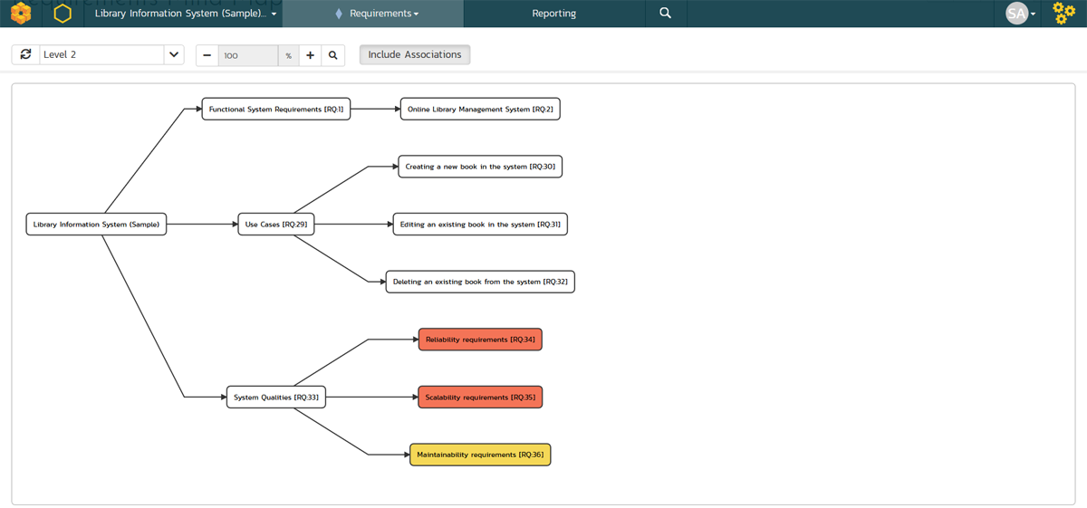
Requirements Management
Requirements management with end-to-end traceability

Slide 37
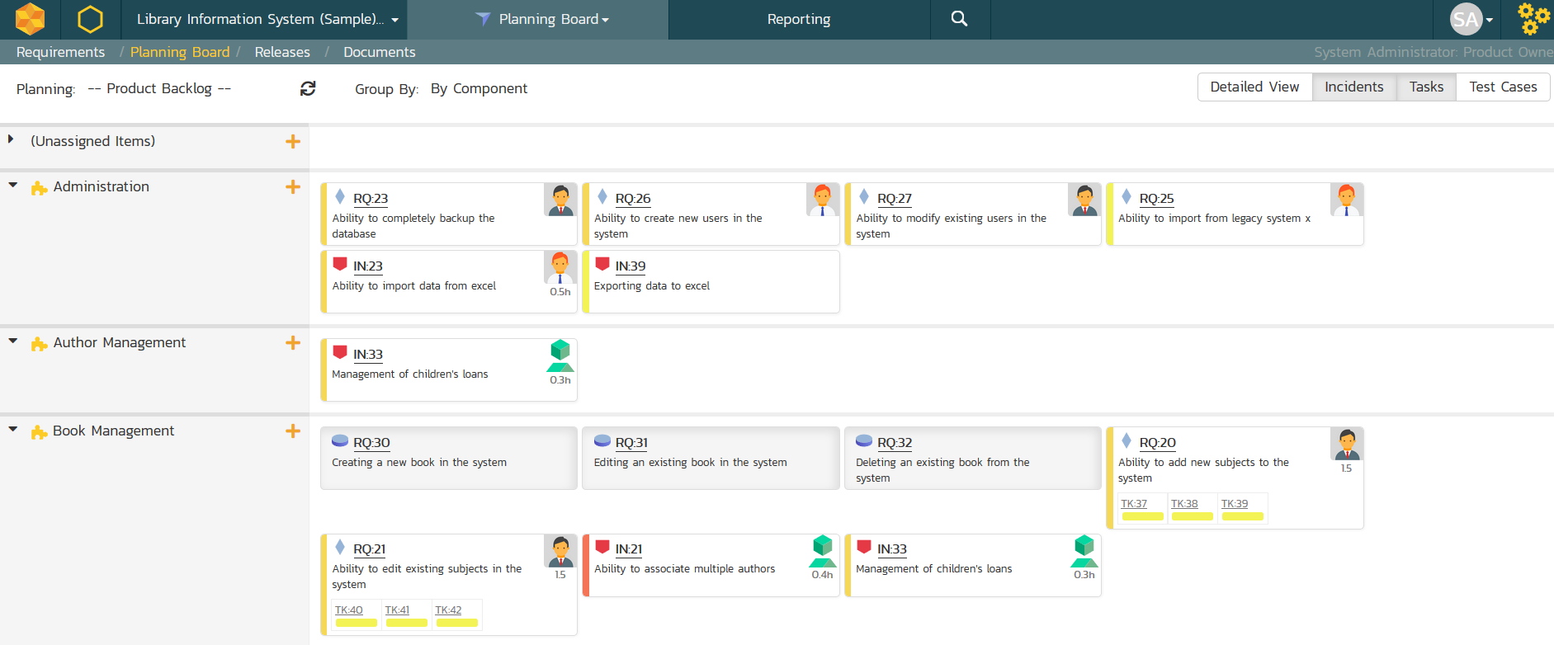
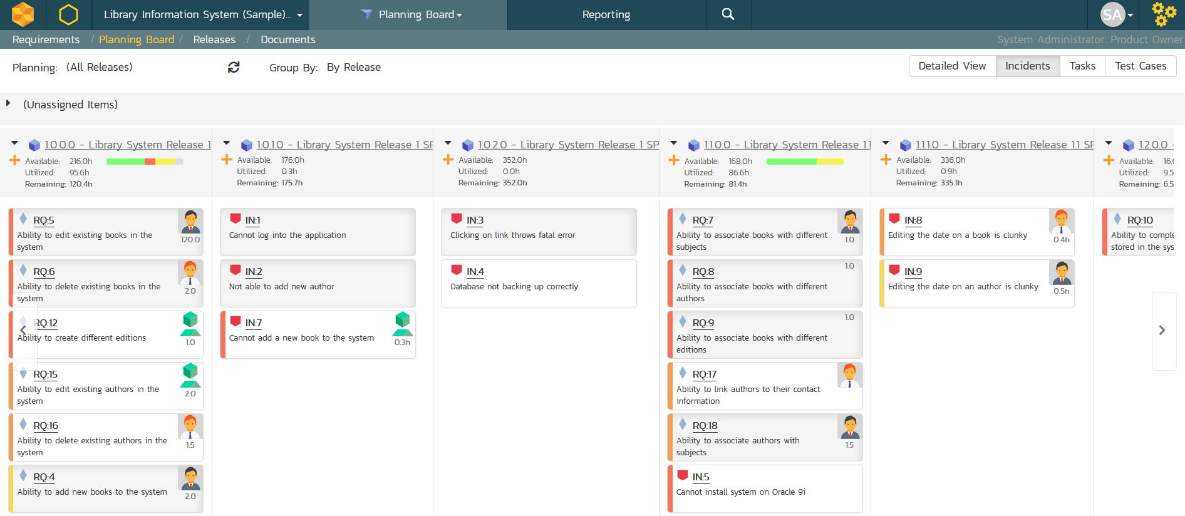
Agile Project Planning
Agile planning boards with test and task traceability that support multiple methodologies including Scrum and Kanban.

Slide 38
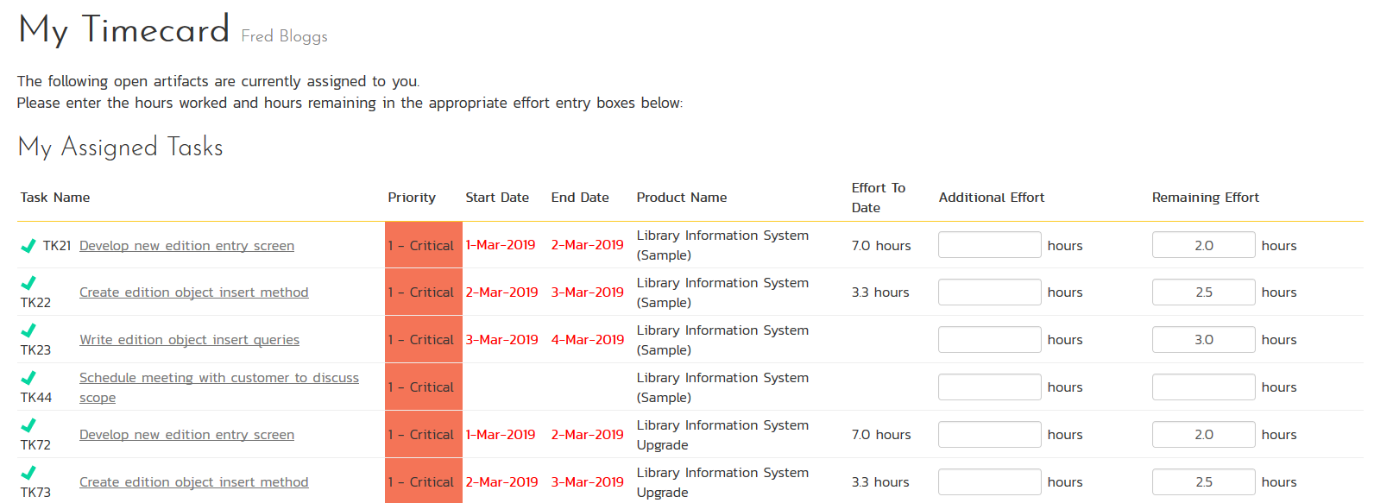
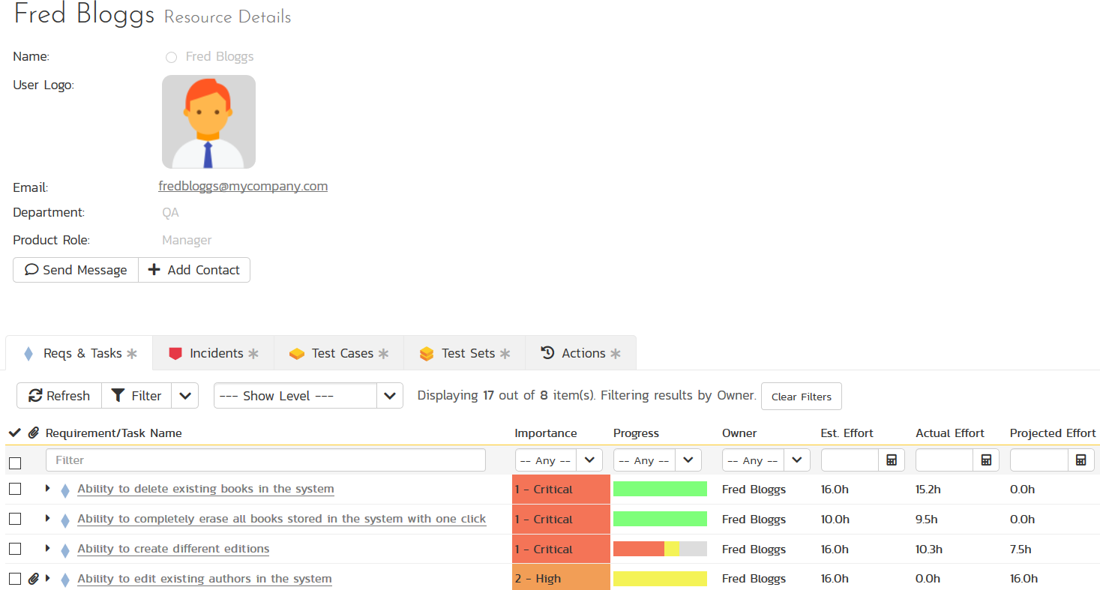
Resource Management
Manage the people and teams on your projects with centralized timecard submission and resource planning.

Slide 39
Document Management
Complete integrated document management system with versioning, check-in/out and approval workflows.

Slide 40
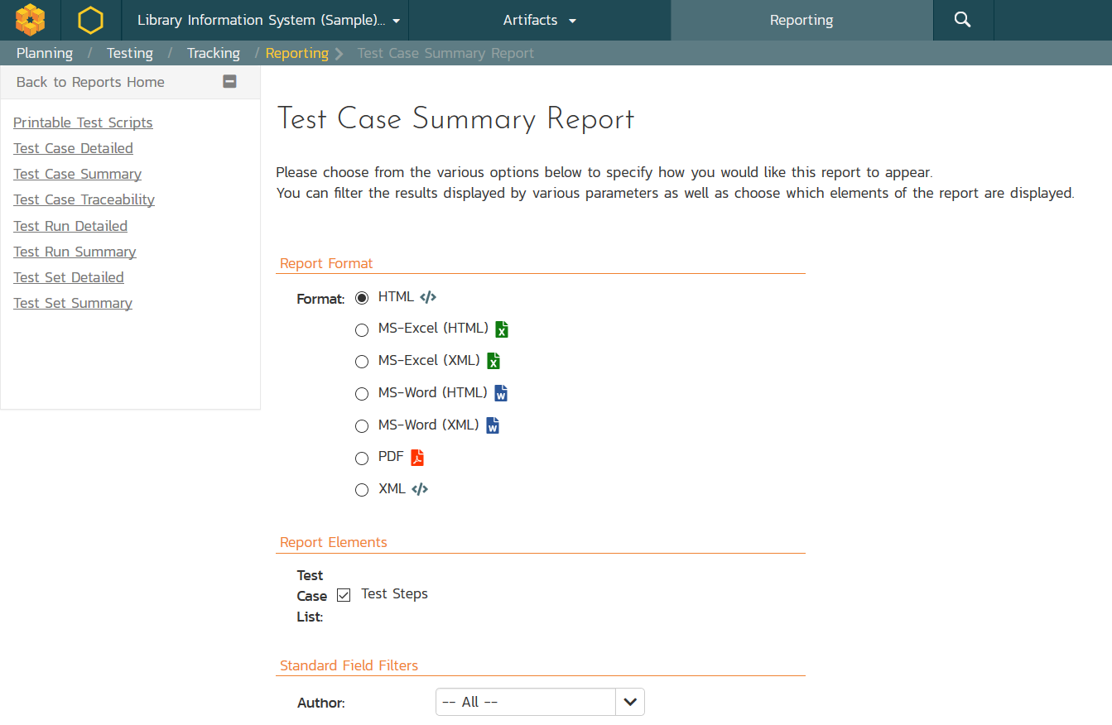
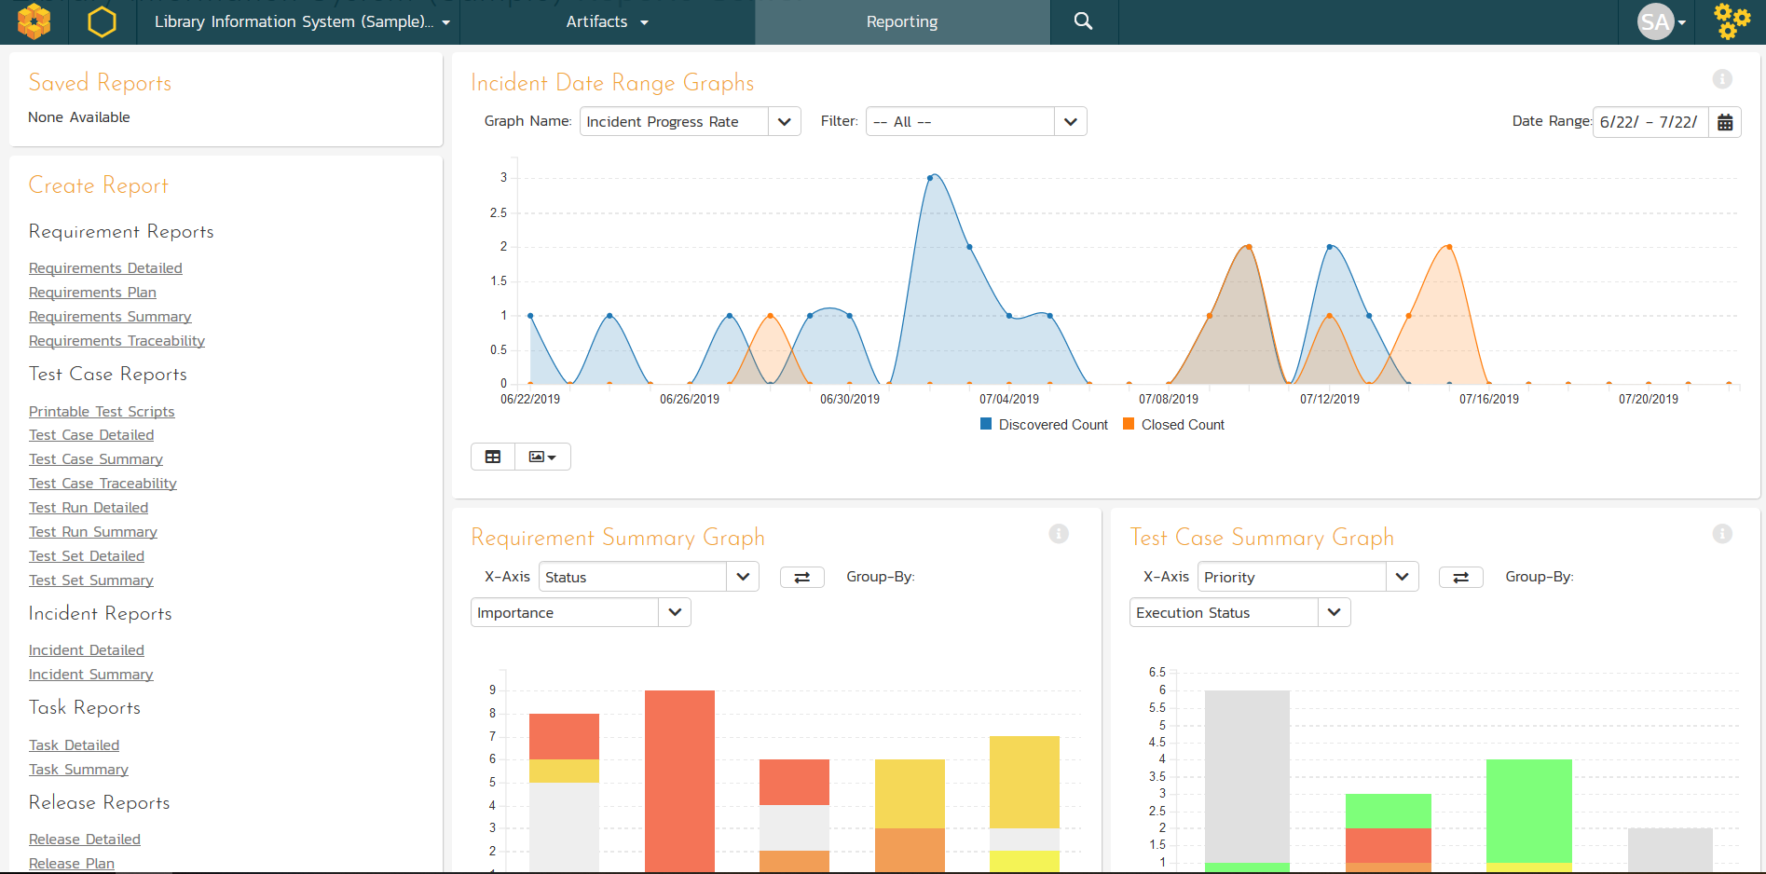
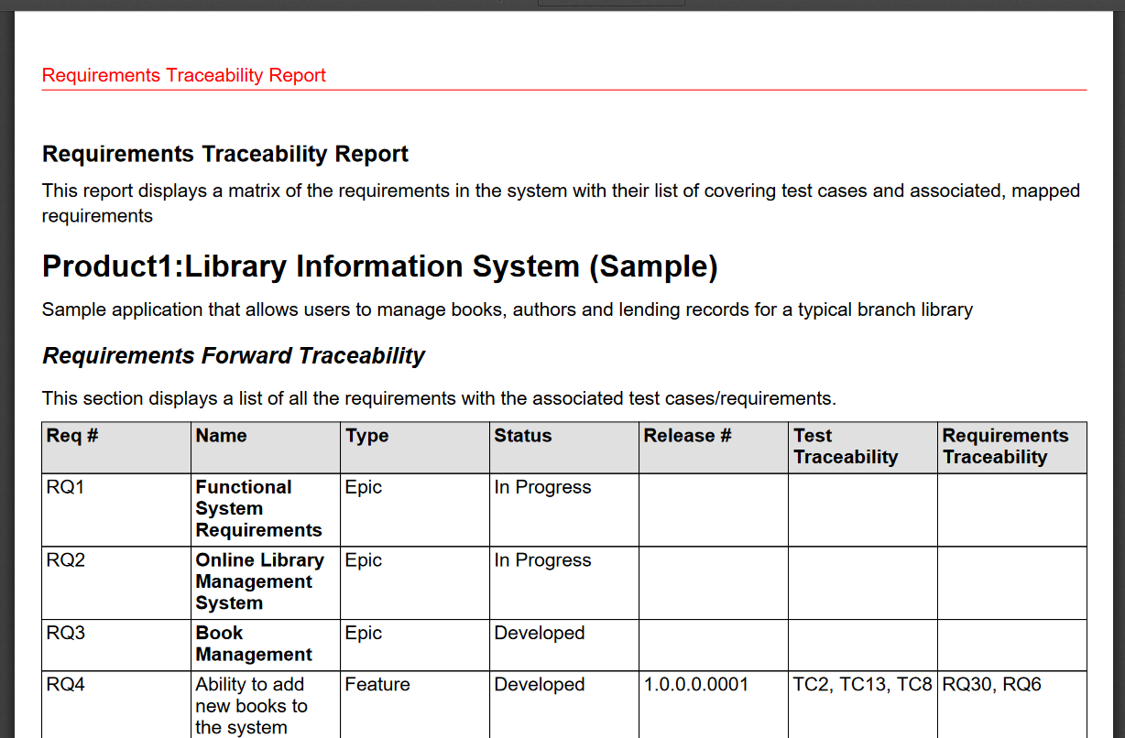
Customizable Reporting
Library of standard and custom reports, export in various formats including Word, PDF, Excel and PDF

Slide 41
Testers
Notes:
That’s the very high level, but what does this mean in detail for you? What have we or are we about to release that can help you? Let’s talk testers first

Slide 42
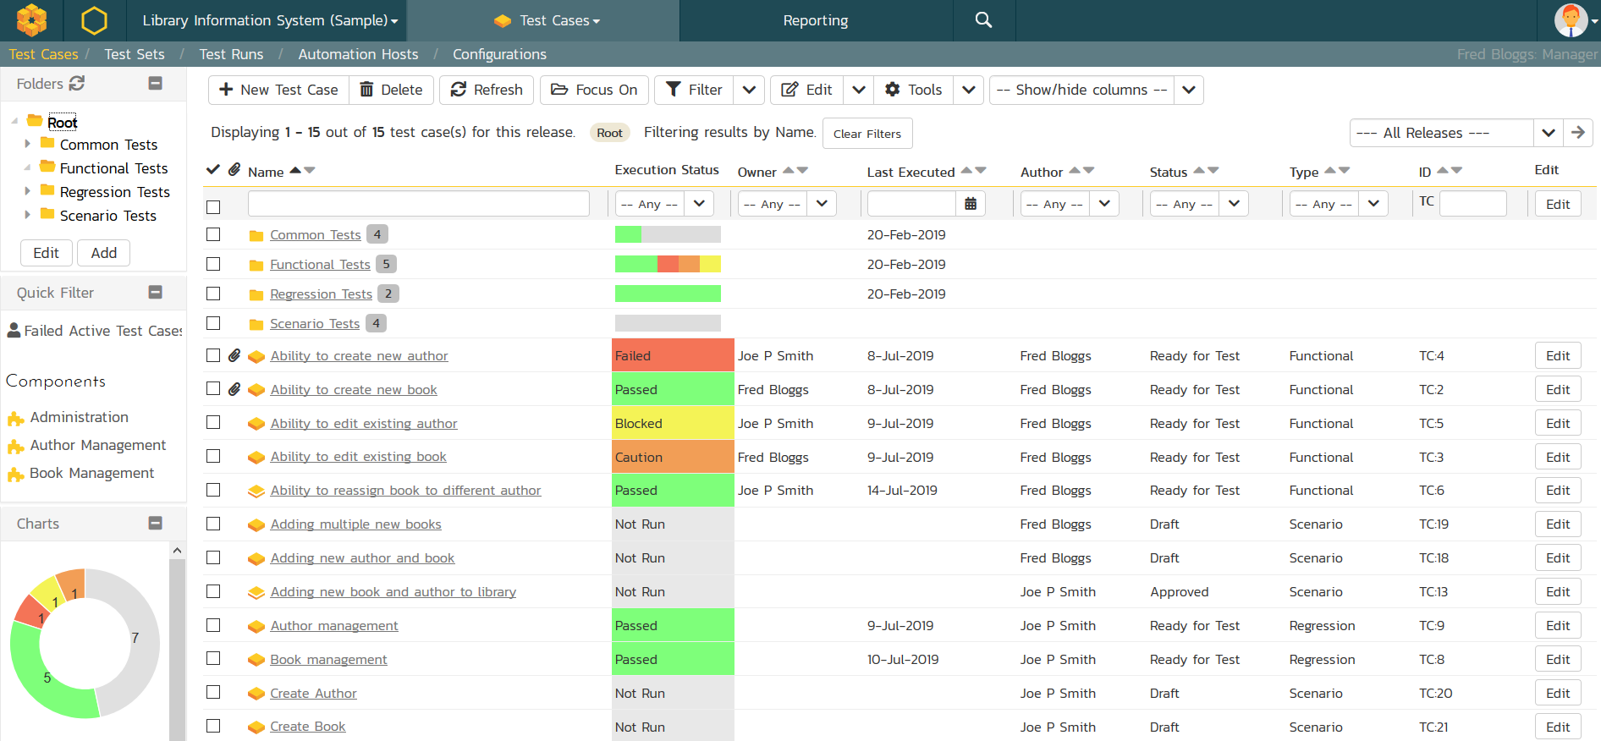
Test Management & QA
Manage your automated and manual test cases, test suites and testing artifacts in a central repository.

Slide 43
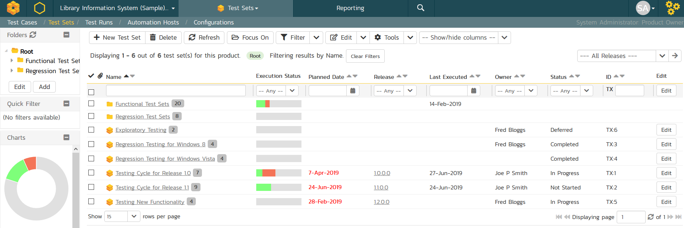
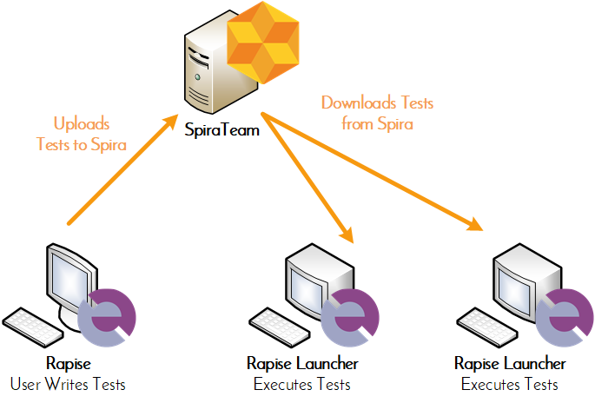
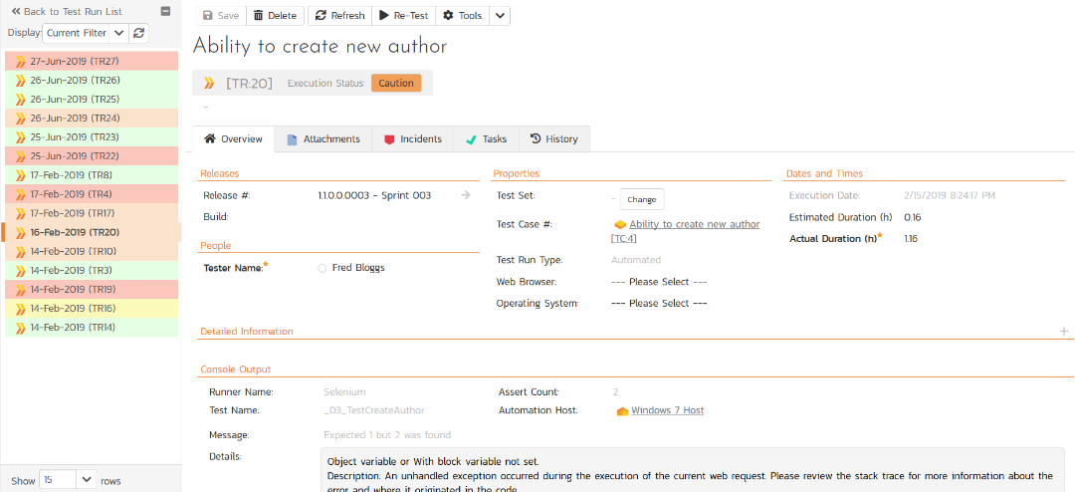
Automated Testing
Orchestrate your automated tests from SpiraTeam, with integrated test lab management and data-driven testing

Slide 44
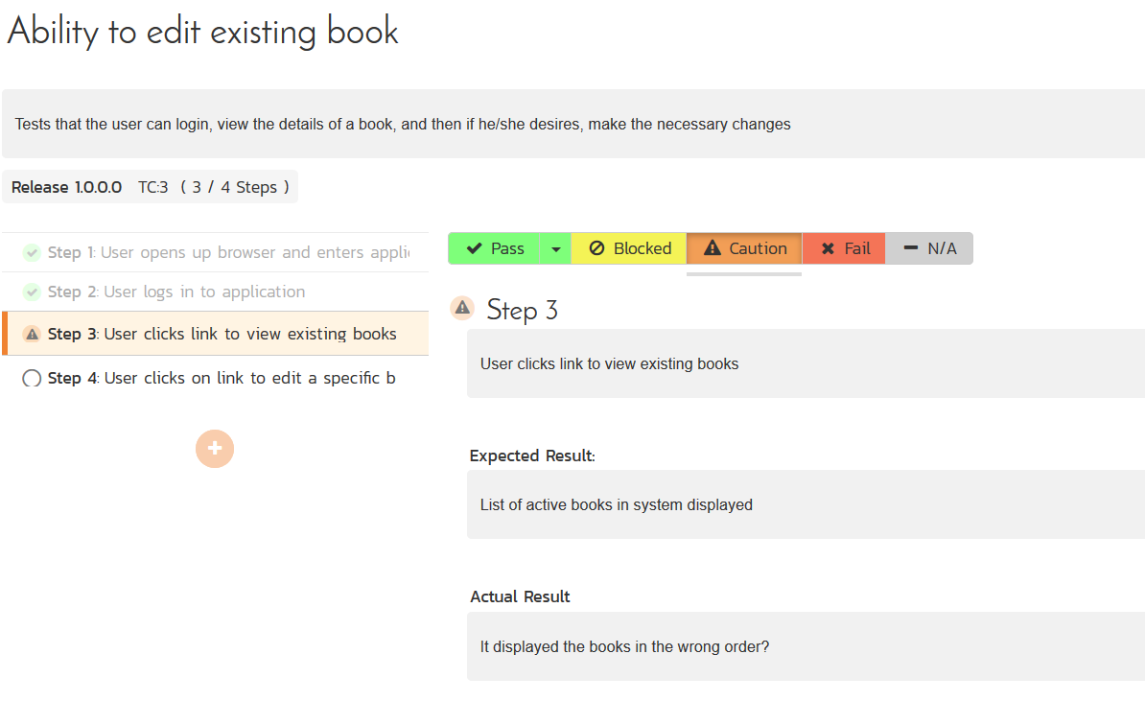
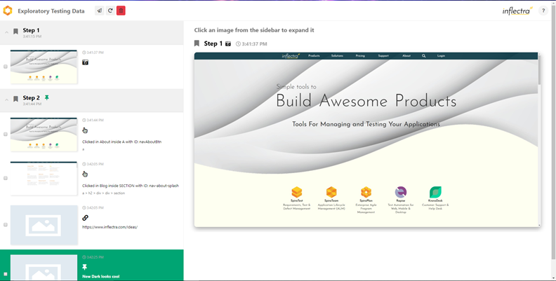
Manual & Exploratory Testing
SpiraTeam provides an easy to use testing wizard for manual and exploratory tests, with SpiraCapture™ for session capture.

Slide 45
Data-Driven Testing
SpiraTeam lets you parameterize your test cases and execute them using different data combinations for full coverage.

Slide 46
Developers
Notes:
Let’s talk next about developers

Slide 47
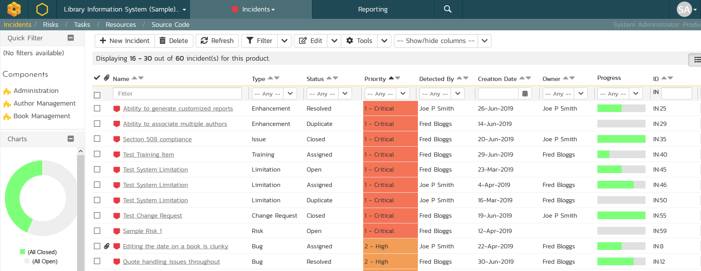
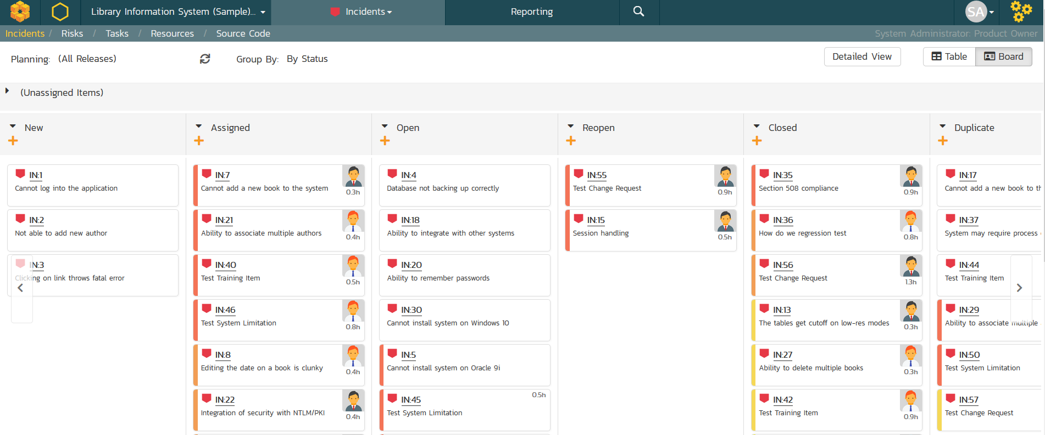
Issue & Defect Tracking
SpiraTeam includes a flexible bug and issue tracker with list and agile board views, and integrated workflow engine.

Slide 48
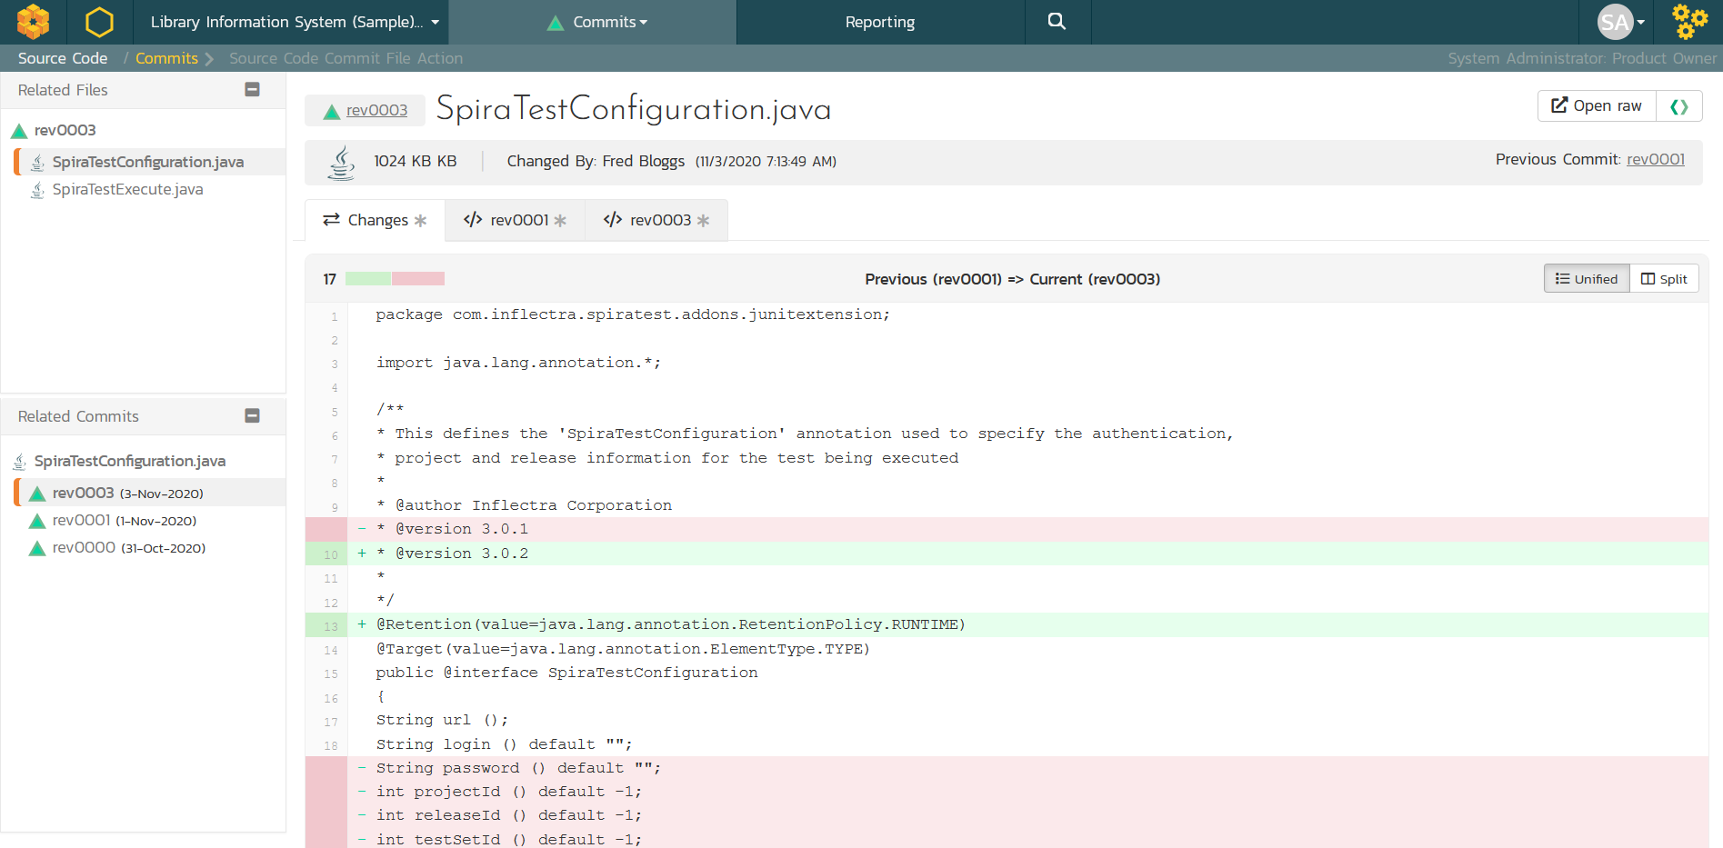
Source Code Management
&
Integrated source code management using Git or Subversion hosted in TaraVault or external. Allows code-level traceability.

Slide 49
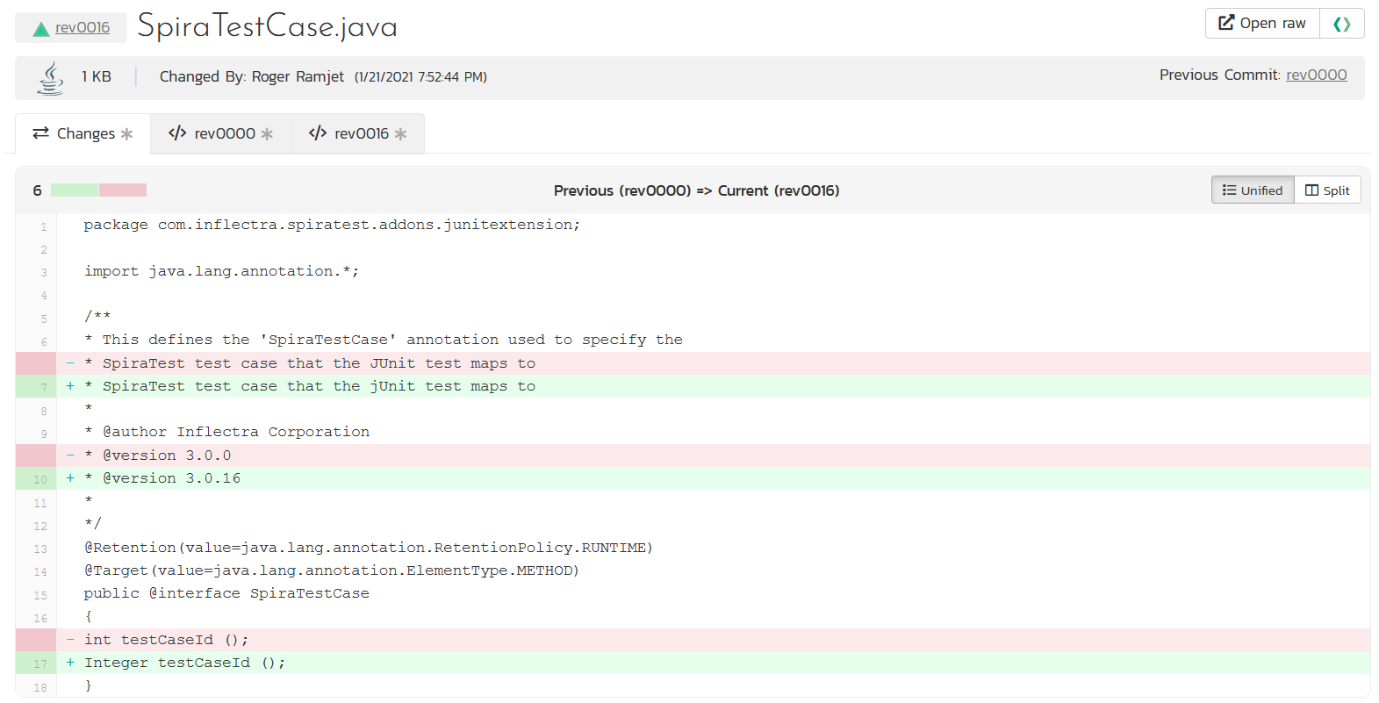
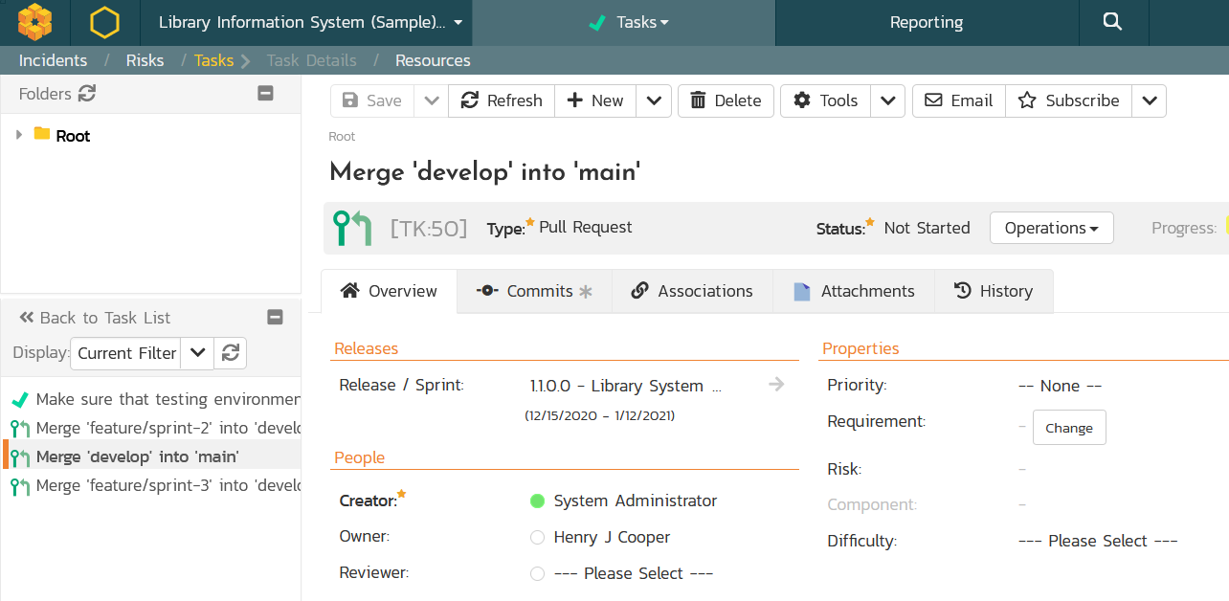
Code Reviews & Pull Requests
Manage your development workflows including merge/pull requests and code reviews with full traceability.

Slide 50
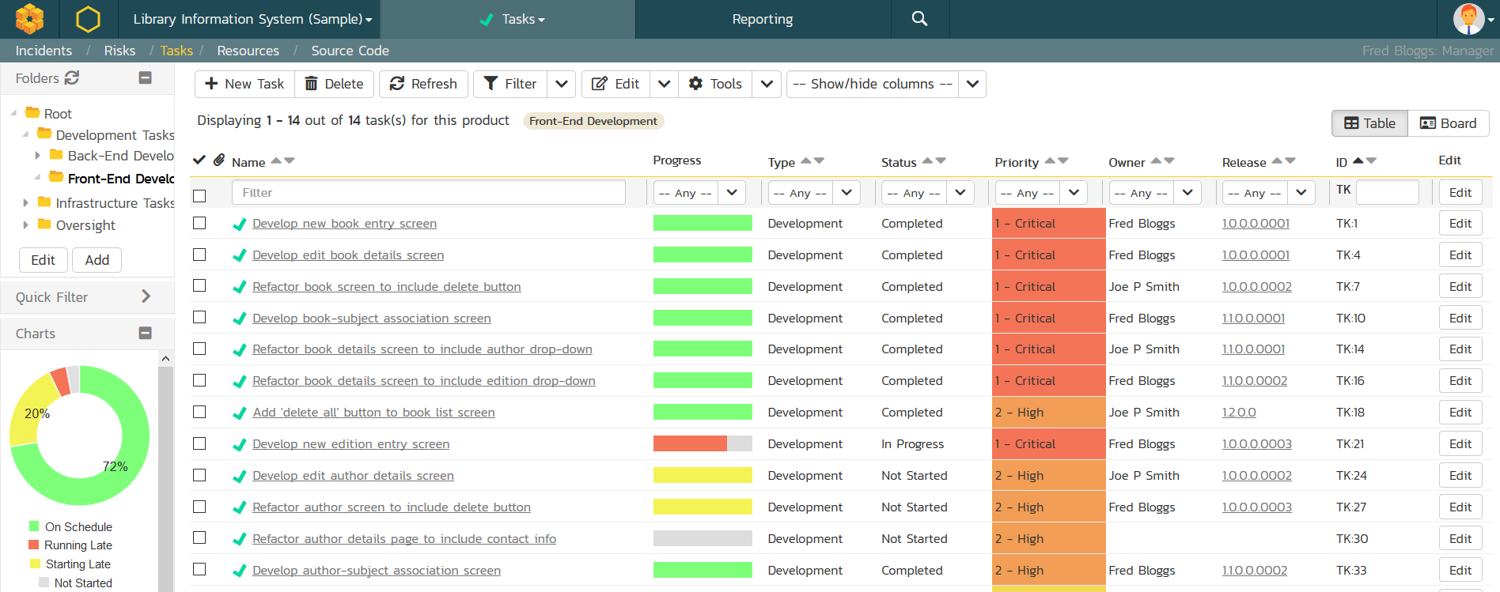
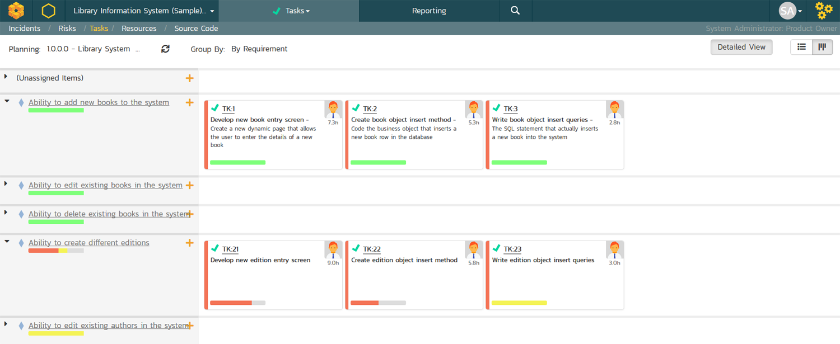
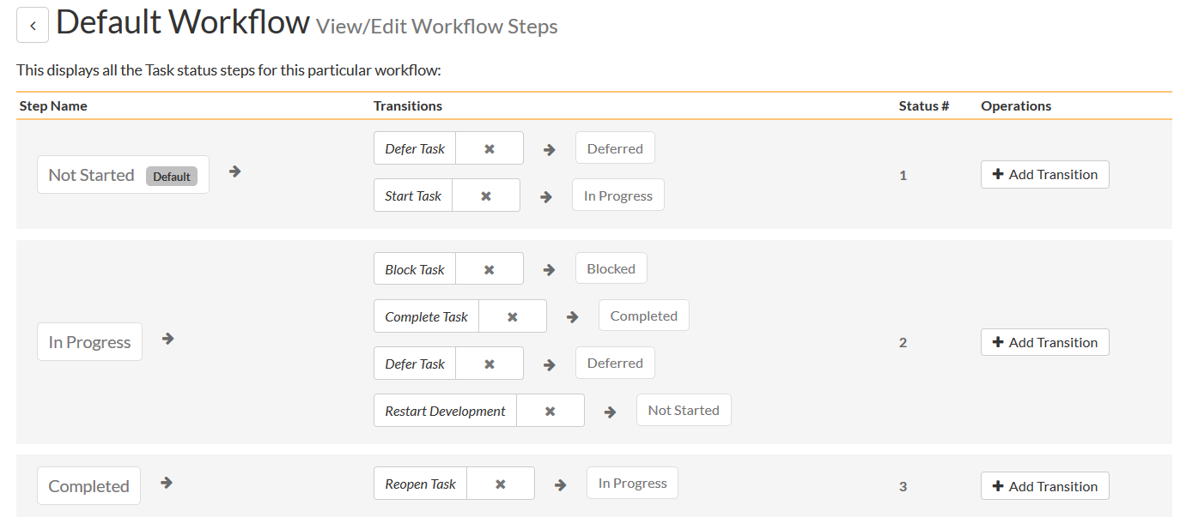
Task Tracking
Track project tasks with customizable workflows. Measure progress against the requirements and user stories

Slide 51
Build Integrated with CI / CD Tools
Build Management in SpiraTeam lets you integrate with continuous integration build servers with full traceability for each build

Slide 52
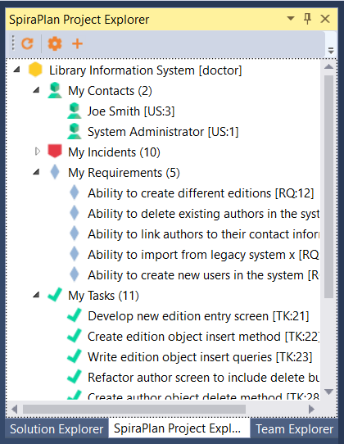
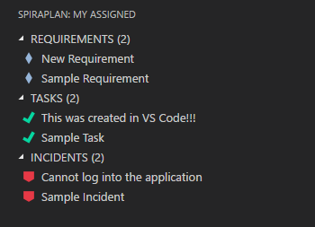
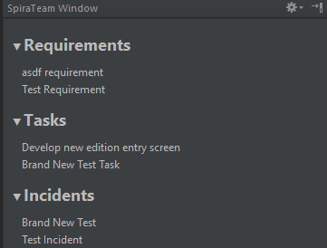
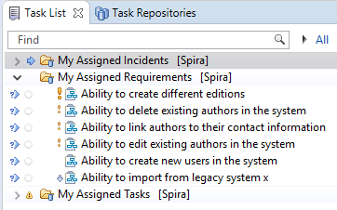
Integration with your Favorite IDEs

Slide 53
Everyone
Notes:
Managers, our third pillar, could always take advantage of our reporting, dashboards, and traceability features. But we knew we could do a lot more to help managers – both senior leaders and those in other roles like BI

Slide 54
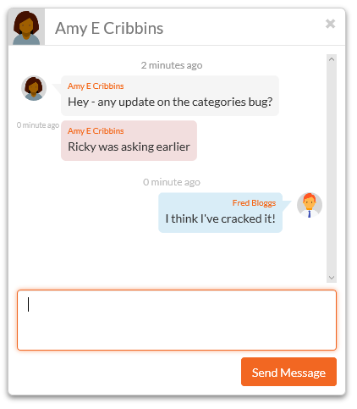
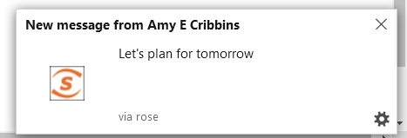
Collaboration and Instant Messaging
Real-time collaboration and communication with SpiraTeam instant messenger, artifact following, RSS Feeds and Email

Slide 55
Integration Options
SpiraTeam Fits into Your Ecosystem Seamlessly

Slide 56
Recap: Harmony Across Ecosystems
We recognize that you need to integrate SpiraTeam with other tools and systems
We make this easy and straightforward so you can get working faster & easier

Slide 57
Open Ecosystem – Over 70 Integrations
IDE
CI/CD
Automation
Unit Testing
Bug-Tracking
Detailed Integration List
Import / Conversion
Load Testing

Slide 58
Questions?

